Slide 1
K Nearest Neighbour
Supervised Learning

Slide 2
K Nearest Neighbour
K-Nearest Neighbours (KNN) is a simple, intuitive machine learning algorithm used for classification and regression.
It works by looking at the K closest data points (neighbors) to a new, unknown data point, based on distance (usually Euclidean distance).
KNN is called a lazy learner because it does not build a model—it makes decisions only when needed.

Slide 3
How KNN works
You have labeled data points (like “cat” or “dog”, or numerical values).
To classify/predict a new point:
Compute its distance to all existing points.
Pick the K nearest ones.
For classification → choose the majority class among neighbors.
For regression → average the values of the neighbors.

Slide 4
Example
A (1, 1) | 0
B (2, 1) | 0
C (1, 2) | 0
D (2, 2) | 0
E (3, 1.5) | 1
F (3, 3) | 1
G (4, 2) | 1
H (5, 3) | 1
I (0.5, 3.5) | 0
J (4.5, 1) | 1

Slide 5
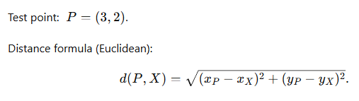


Example

Slide 6
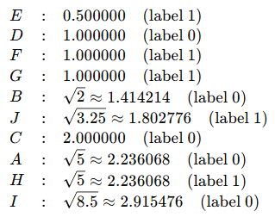
Example
Distance from P to all points (closest to farthest)

Slide 7
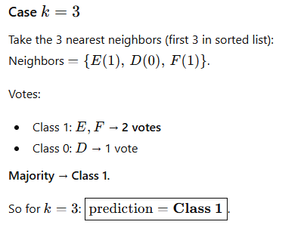
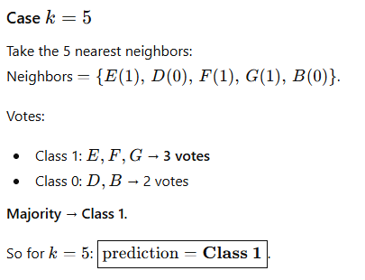
Example

Slide 8
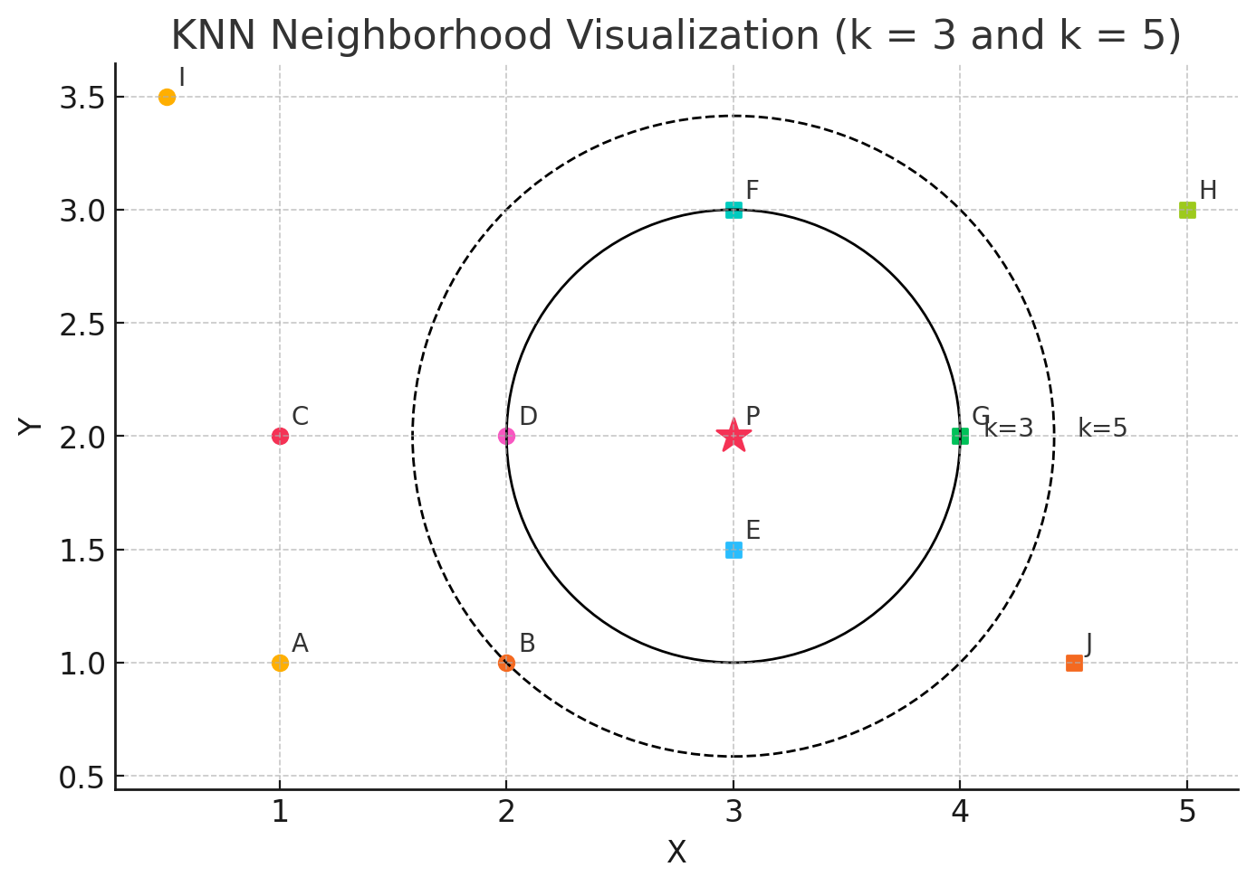

Slide 9
Properties
📌 When to use KNN?
Small to medium datasets
When data is not too high-dimensional
When interpretability is important
📌 When it struggles?
Very large datasets (slow)
High dimensional features (curse of dimensionality)
Features with different scales (need normalization)

